Slide 1
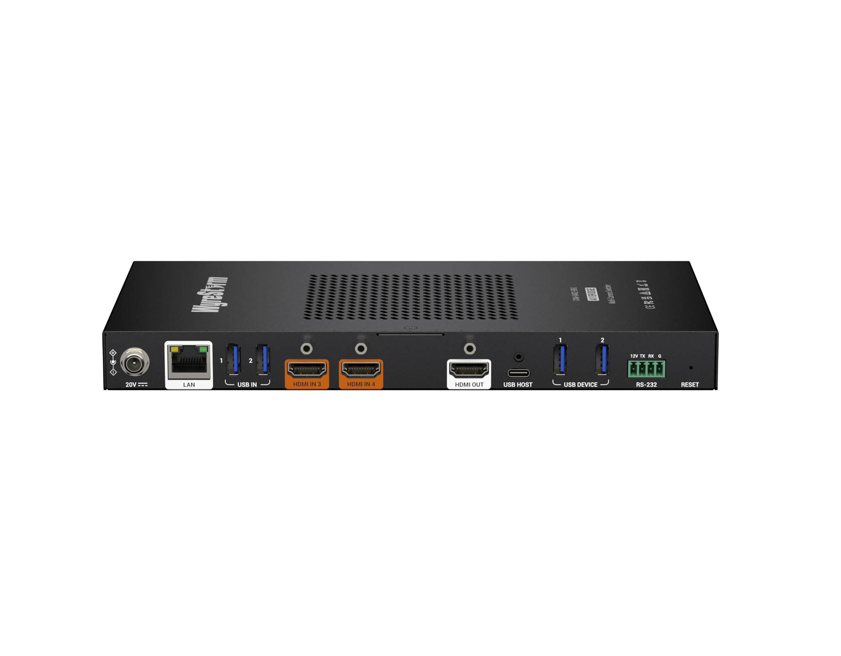
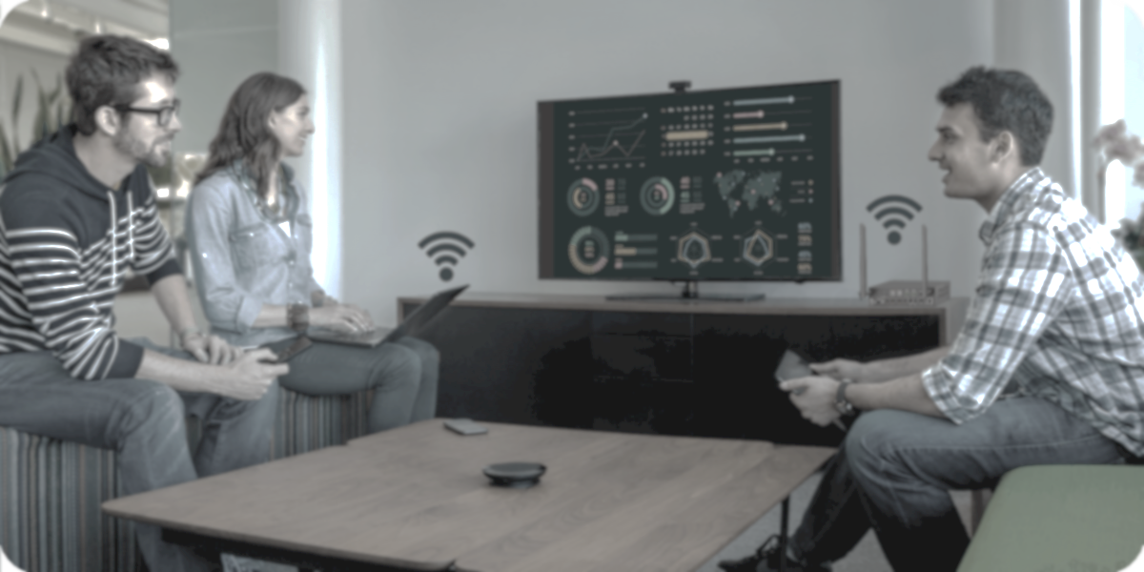

CAM-0402-BRG
Product Guide
Multiple Camera Switcher with A/V Bridge
(Bi-directional HDMI-USB)
Multiple Camera Solution Manufacturer

Slide 2

Contents
Product Overview & Key Features
Why Choose Us?
Interface & Specifications
Typical Connection & Applications
Competitor Analysis
Quick Installation Guide & Web UI Introduction
Q & A Session
Powerful · Reliable · Simple

Slide 3

Product Overview
Multiple Camera Switcher with A/V Bridge (Bi-directional HDMI-USB)
The CAM-0402-BRG is a multi-camera switcher with USB and HDMI inputs (2x USB & 2x HDMI) and outputs (1x USB & 1xHDMI). It enables fast and seamless switching with no black screen, ensuring a smooth video experience. It also supports multiview modes (PIP, Pyramid, Quad, etc.), allowing multiple camera feeds to be displayed clearly within a single image -- ideal for hybrid teaching and collaborative meetings. Additionally, the device functions as a bi-directional A/V bridge between HDMI and USB, allowing users to connect HDMI or USB cameras and route the signal to an HDMI monitor or laptop via the USB host port.
This highly versatile and easy-to-install solution is ideal for collaborative meetings and remote education scenarios where multiple camera angles are required, or HDMI content needs to be captured and transmitted along with camera feeds.
Powerful · Reliable · Simple

Slide 4








Main Features
Comprehensive Camera Input Options
Offers a variety of inputs, including USB and HDMI, ensuring compatibility with cameras used in conferences, meetings, and educational settings.
Fast Seamless Switching Between Multiple Cameras
Eliminate black screens during source switching between different cameras, enhancing viewing experience with smoothy and clarity image.
Bi-directional A/V Bridge Between HDMI and USB
This advanced feature allows users to connect HDMI or USB cameras and stream the signal to an HDMI monitor or laptop via the USB host port—delivering a seamless and enhanced multi-camera viewing experience.
Reliable and High-Quality Resolution
4K resolution guarantees sharp and clear video, delivering a fully immersive presentation experience.
Multiview Mode Support
Displays up to 4 camera sources simultaneously on one screen (PIP, Pyramid, Quad, etc.), to provide an efficient, comprehensive and real-time overview.
Independent 2-in-1 USB 3.0 Hub
The device integrates a 2-in-1 USB 3.0 hub, allowing connection of USB peripherals—like speakerphones or mice—to a laptop via the USB 3.0 host port, delivering streamlined integration and a smoother workspace experience.
Effortless Setup and User-friendly Operation
Plug-and-play with zero configuration required, offering hassle-free setup and immediate operation out of the box. This feature makes it exceptionally user-friendly, particularly in fast-paced or non-technical environments.
Flexible Control Approaches
Offers various control methods, such as control button, API (RS232 & Telnet), and Web-UI, allowing for convenient management and configuration of the camera.
Powerful · Reliable · Simple
Notes:
* Do not introduce NDI, until NDI is all done;

Slide 5
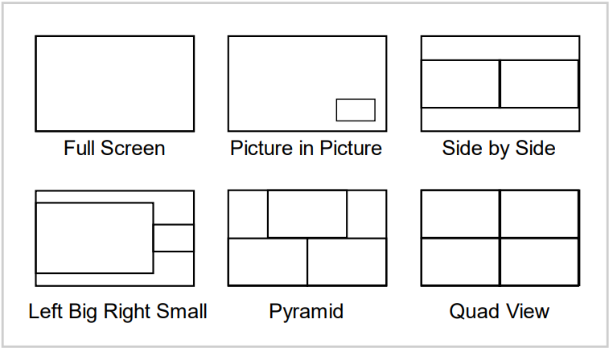
Why Choose Us: 1. Immersive Viewing Experience
Deliver an immersive viewing experience with 4K@30Hz 4:4:4 resolution, seamless switching, and support for multiview modes — ensuring stunning detail and smooth visuals for the audience.
High-Quality Video Performance
Fast and Seamless Source Switching
Provide high-quality 4K@30Hz 4:4:4 8bit resolution for detailed information on HDMI and USB output, providing superior visual quality for your presentations.
It delivers fast and seamless source switching without black screen, ensuring a consistently smooth video experience.
Multiview Mode Supports
Offers multiple layouts (PIP, Pyramid, Quad, etc.), to provide a comprehensive and real-time overview on a single screen -- ideal for collaborative environments, monitoring, and streamlined decision-making.
Powerful · Reliable · Simple

Slide 6
Why Choose Us: 2. Creating Hybrid Environment with Multi-Camera
With excellent camera adaptability, Integrated 2-in-1 USB Hub, and efficient operation in hybrid environments, the system allows all meeting participants to easily contribute and collaborate productively.
Excellent Camera Adaptability
Built-in USB 3.0 Hub
Equipped with a bi-directional A/V bridge (HDMI - USB), the device supports a diverse array of camera models. It enables the integration of multi-camera, intelligent video solution into the hybrid experience.
Works flawlessly with extra speakerphones, keyboard, mouse, and other USB 3.0 peripherals, delivering a seamless and superior hybrid working experience.
Efficient Operation in Hybrid Meetings
Enhance the efficiency of hybrid meetings with a user-friendly Web-UI or by integrating with SYN-TOUCH10.
Powerful · Reliable · Simple

Slide 7
Why Choose Us: 3. Plug & Play, Guest-Friendly
Simplify setup with plug-and-play functionality, allowing for guests to connect and present without any hassle.
Flexible Control Methods
Plug-and-Play, user-friendly
Offers multiple control methods (buttons, API, Web-UI), allowing for convenient management and configuration of the camera switcher.
Plug-and-play functionality means zero configuration is required, offering hassle-free setup and immediate operation out of the box, making it exceptionally user-friendly.
Secure Network Access
Independent Ethernet port, IP Setting and advanced protocols like HTTPs, Telnet over TLS, make sure the communication is security and user privacy is fully protected.
Powerful · Reliable · Simple

Slide 8
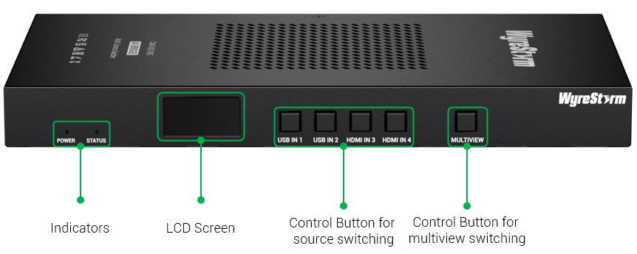
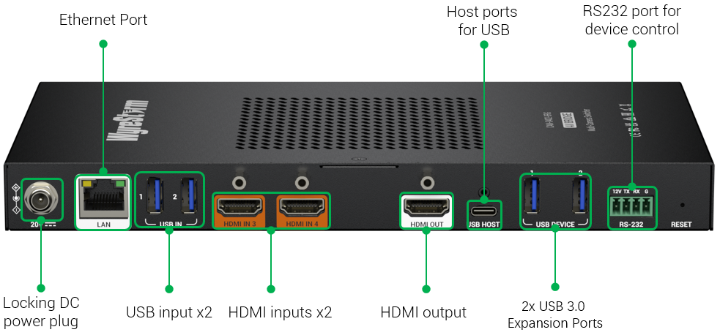
Interface of the Product
Front Panel
Featuring:
2x USB IN & 2x HDMI IN
All four ports connection of 4K camera, and it offers fast seamless switching between different sources for a better viewing experience.
HDMI OUT & USB Host
Two output video signals, the USB Host output has mirroring HDMI output, both of these two outputs can support up to 4K@30Hz resolution.
2x USB3.0 Expansion Ports
Easily connect speakerphone, keyboard or other USB 3.0 peripherals to your laptop for flexible settings.
Rear Panel
Powerful · Reliable · Simple

Slide 9
Specifications & Packing List
Main Specifications
Input Video Ports | 2x USB 3.0, 2x HDMI (HDMI 1.4)
Output Video Ports | 1x HDMI, 1x USB Host;
Video Resolution (Max) | HDMI Output: 4K@30Hz 4:4:4 8bit USB: 4K@30Hz (MJPEG)
Multiview Mode | PIP | Side-by-Side | Pyramid | Quad etc.
USB | 2x USB-A: USB 3.0 | Max Bandwidth: 5.0 Gbps * USB peripherals connected to your PC
USB Protocols | UAC | UVC
Ethernet | 1x LAN: 8-pin RJ-45 Female | Web-UI | API
RS232 | 1x 4-pin 3.5mm Phoenix Connector (API Control)
Control Method | Front panel buttons | Web-UI | API (RS232 & Telnet)
Power Supply | 20V DC 3A
What’s in the Box?
1x CAM-0402-BRG;
1x 20V/3A Power Supply (US/UK/EU/AU);
1x 4-pin Phoenix Connector (for RS-232);
4x Mount Bracket and Screws;
1x Quick Start Guide;
Powerful · Reliable · Simple

Slide 10
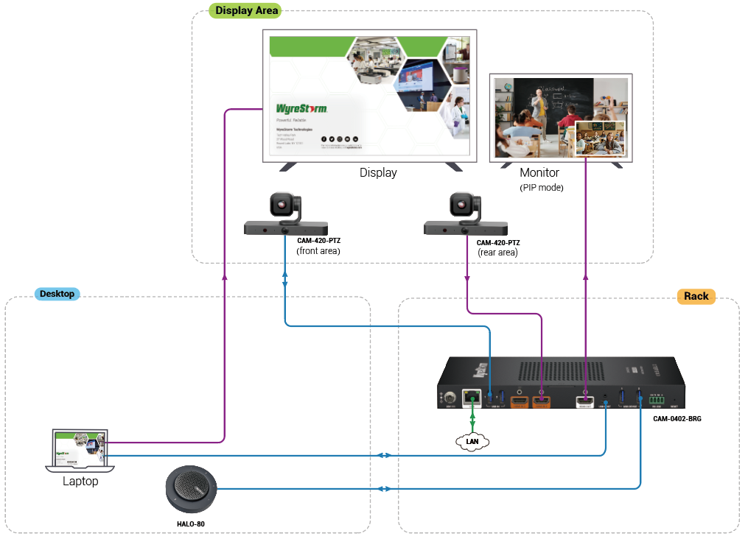
Typical Connection & Applications
Application Scenario 1: Conference Room, Classroom (Multi-camera)
This solution simplifies installation by supporting multiple cameras and featuring a plug-and-play design. It significantly improves the efficiency of remote meetings and educational sessions, ensuring every meeting is productive and seamless.
Key Benefits Include:
Fast and Seamless Multi-Camera Switching: Switch between up to four HDMI/USB cameras with ultra-fast transitions and zero black screens—ensuring a fluid and uninterrupted viewing experience.
Bi-directional A/V Bridge between HDMI and USB: A reliable HDMI - USB bi-directional bridge that is fully compatible with all USB and HDMI cameras.
Multiview Display Modes: Supports multiple layouts (PIP, Pyramid, Quad, etc.) to provide a comprehensive, real-time overview on a single screen.
Flexible Room Configuration: Provides multiple control methods, including Buttons, Web UI & API (Telnet, RS232), and a user-friendly Web UI.

Slide 11
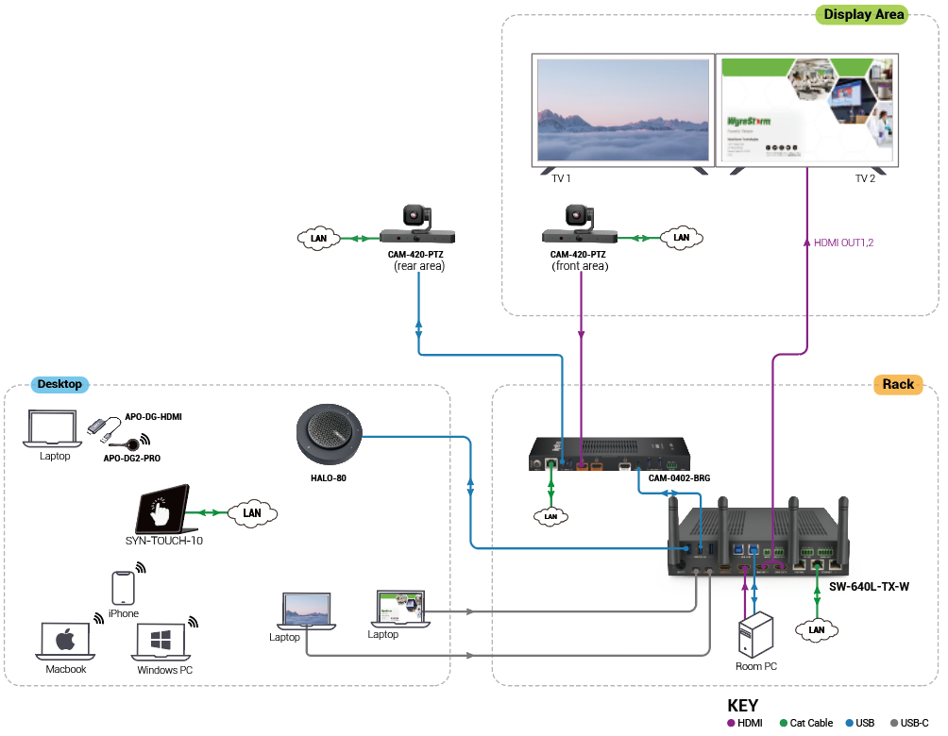
Typical Connection & Applications
Application Scenario 2: Multi-camera setups, working with other products
The WyreStorm multi-camera solution combines multiple cameras, an audio system, and flexible room configurations into a powerful setup. The camera switcher (CAM-0402-BRG) plays a critical role by handling multiple cameras, ensuring a fully immersive hybrid experience.
Key Benefits Include:
Better Wireless Casting Experience: Working with SW-640L-TX-W, casting superior image by various cameras.
Fast and Seamless Multi-Camera Switching: Switch between up to four HDMI/USB cameras with ultra-fast transitions and zero black screens—ensuring a fluid and uninterrupted viewing experience.
Multiview Display Modes: Supports multiple layouts (PIP, Pyramid, Quad, etc.) to provide a comprehensive, real-time overview on a single screen.
Flexible Room Configuration: Provides multiple control methods, including Buttons, Web UI & API (Telnet, RS232), and a user-friendly Web UI.

Slide 12
Comparison with Other Competitors
Specification |  | CAM-0402-BRG | InfoBit iTrans UC-HUB2U | AVer MT300N | Inogeni Share2U
Input | Video Input | 2x HDMI | 1x HDMI | 3x HDMI | 1x HDMI
 | Video Input Timing | 4K@30Hz 4:4:4 8bit | 1080p@60Hz | 1080p@60Hz | 1080p@60Hz
 | USB Input | 2x USB 3.0 Type-A | 1x USB 2.0 Type-A 1x USB 3.0 Type-A | 3x USB 2.0 Type-A | 2x USB 2.0 Type-A
 | USB Input Timing | 1x 4K@30Hz (or 2x 1080P@30Hz) | 1080p@30Hz | 1080p@60Hz | 1080p@30Hz
Output | Video Output | 1x HDMI | 1x HDMI | 2x HDMI | 1x HDMI
 | Video Output Timing | 4K@30Hz 4:4:4 8bit | 4K@60Hz | 4K@60Hz | 1080p@60Hz
 | USB Output | 1x USB 3.0 Type-C | 1x USB 3.0 Type-C | 2x USB 3.0 Type-B | 1x USB 3.0 Type-B
 | USB Output Timing | 4K@30Hz | 1080P@30Hz | Unknown | 1080p@60Hz
 | Multiview | Quad View (Up to 4 windows) | Dual View | No | Dual View
Others | USB Peripheral Interface | 2x USB 3.0 Type-A | No | No | 2x USB 3.0 Type-A
 | Audio Interface | No | 1x Analog in, 3.5mm TRS Jack 1x Analog Out, 3.5mm TRS Jack | Dante USB | 1x Analog in, 3.5mm TRS Jack 1x Analog Out, 3.5mm TRS Jack
 | RS232 | Yes | Yes | No | Yes
 | Control Approach | Button Web API (RS232/Telnet) | Button Web API (RS232/Telnet) | Automatic (Active Position) Web API (RS422) | USB HID Button API (RS232/Telnet)
 | Additional Feature | Audio mixer | Audio mixer PoE |  | Audio mixer
Notes:
Advantage:
4K@30Hz 4:4:4 8bit, bi-directional A/V bridge (HDMI - USB), 完整的USB系统功能；
Multiview, audio;
Other features:
Aver MT300N, Crestron IV-SAM-VX2-P -- voice tracking feature, multi-camera solution, multi-camera switcher;
后续发展：
NDI -- 已经规划，NDI技术在其他产品上已经实现CAM-420-PTZ，CAM-210-NDI-PTZ；
camera switcher -- camera进行控制；
Voice tracking (?)；

Slide 13

Quick Installation Guide
Effortlessly set up your camera switcher with simple steps, ensuring seamless configuration and an exceptional hybrid experience.
Connect Interfaces: Follow the standard product connection guidelines and customize connections based on your environment’s layout for optimal performance.
Start the Device: Use ‘Quick Start Guide’ to locate the device's IP address, then log into the Web-UI for easy equipment configuration.
Select the mode of image: Select your multiview layout using the Web-UI. For detailed instructions, refer to the user manual.
Enjoy Superior Visuals: Experience stunning video clarity and immersive visuals tailored to your needs.
Powerful · Reliable · Simple

Slide 14
Important Notes for Installation
Ensure all cables are securely connected to avoid performance issues.
Check your network settings and confirm that the device is on the correct subnet.
Double-check configuration settings in the Web-UI to optimize display and functionality.
For complex installations, refer to the documentation or seek professional assistance if necessary.
Powerful · Reliable · Simple

Slide 15
Introduction of Web Configuration Interface
The Web UI of the CAM-0402-BRG camera switcher is designed for intuitive device management and control through any web browser. With the Web UI, you can easily configure and select mulitview mode with following features:
Web UI Functionality:
Interface: Effortlessly manage device settings via a web browser.
Setting up: Camera source routing, audio settings, multiview mode select, and USB settings.
Control: Set up and adjust camera source inputs, outputs, and system settings.
Key Web UI Configurations:
General Settings: Configure IP settings, manage security, and perform firmware updates.
Video Inputs/Outputs: Manage camera source, select HDMI or USB source.
Multiview Settings: Easy setting up to select the mulitiview mode.
Control Settings: Enable RS-232 for device control and CEC for display control.
Powerful · Reliable · Simple

Slide 16

Final Thoughts
Q & A Session
Got questions? Don't hesitate to ask away.
Powerful · Reliable · Simple

